Slide 1


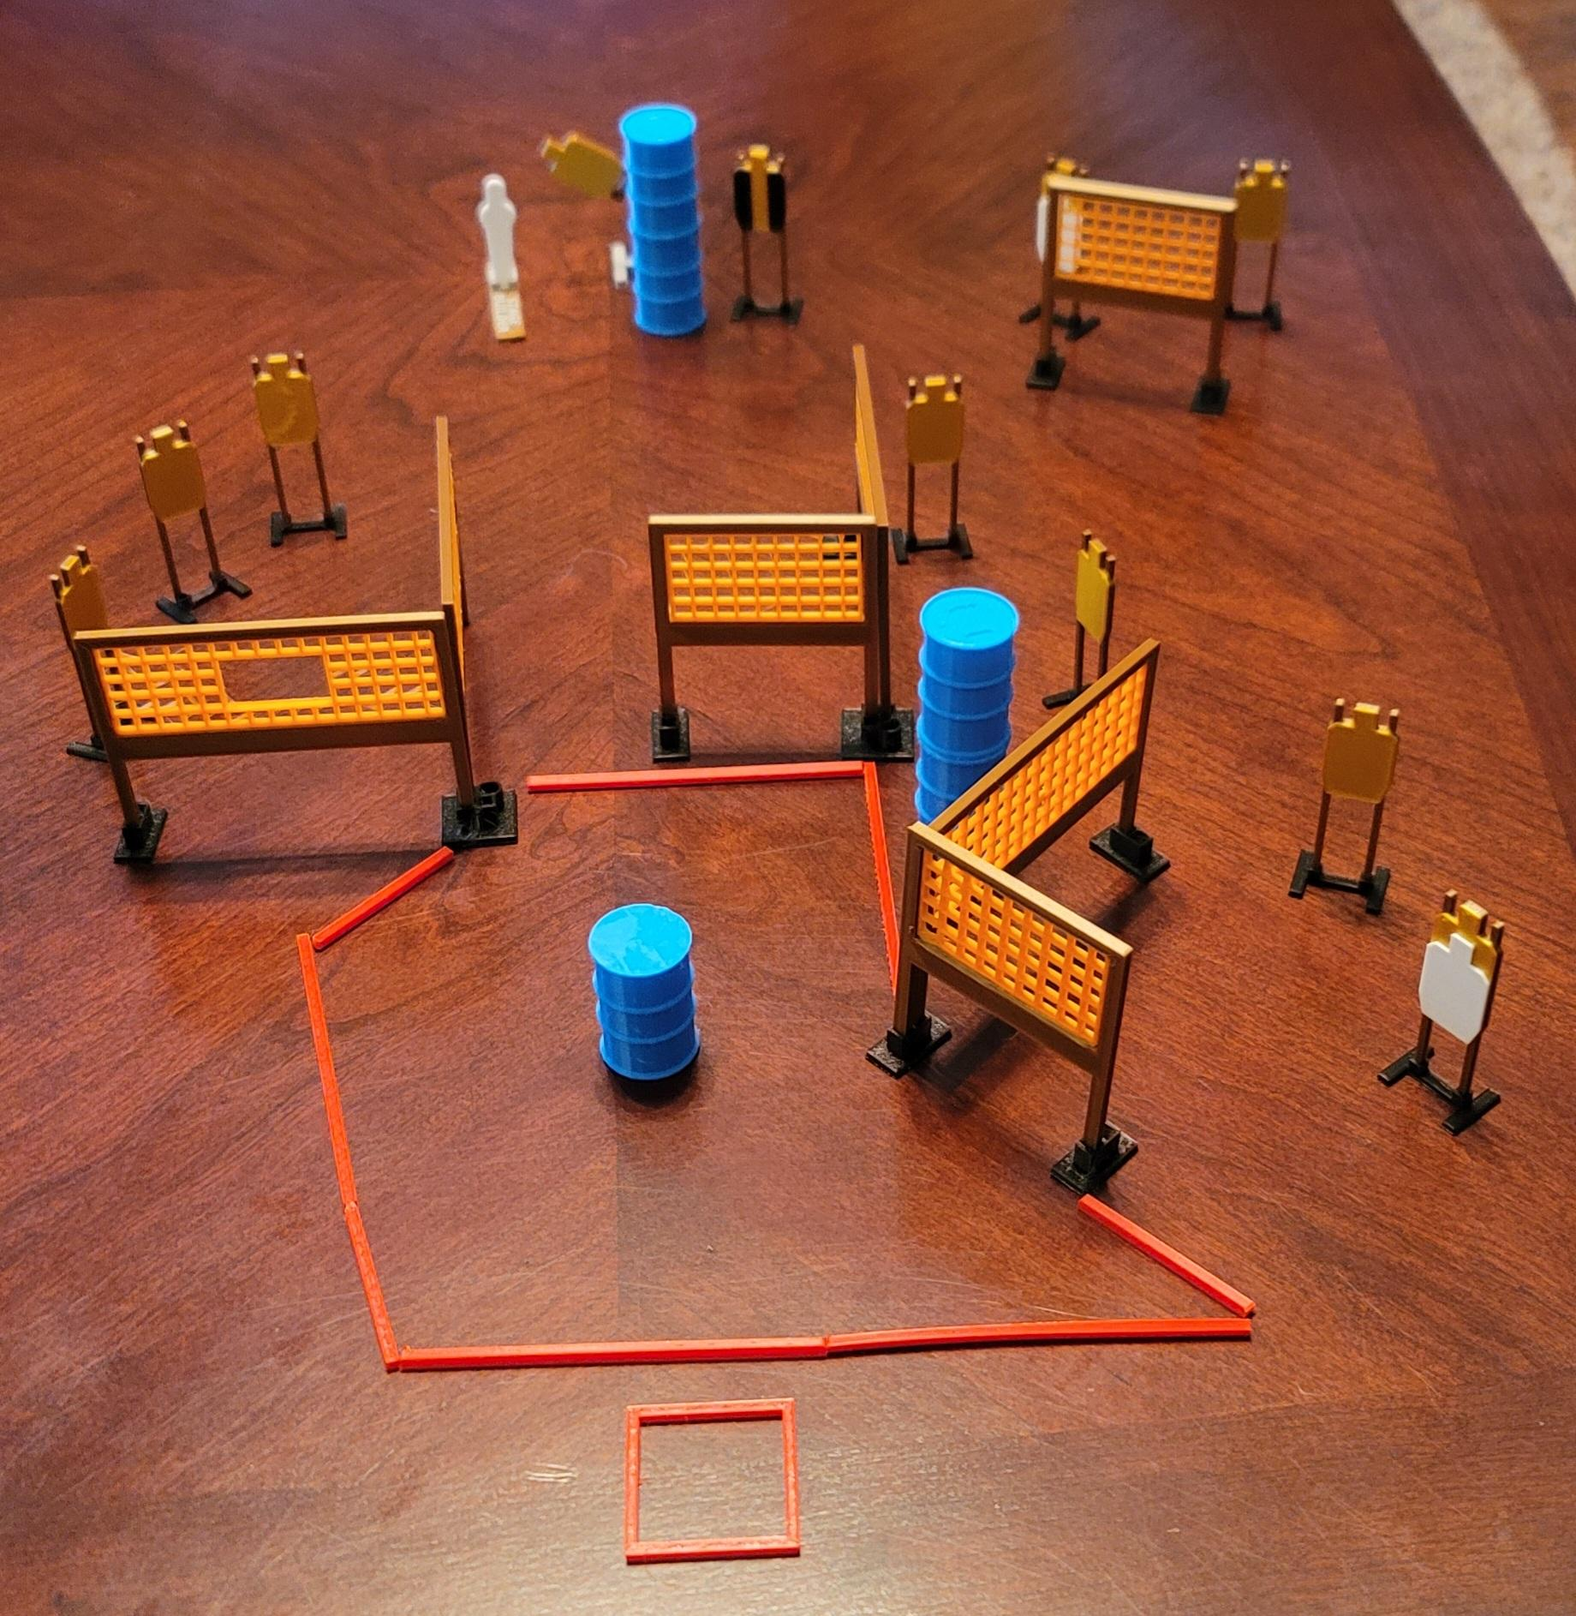
 | Dothan Gun Club – USPSA Match Pick it up and go! Course Designer : Eric Henwood
Round Count 23 rounds 11 USPSA 1 pepper popper
Equipment List 11 wall feet 2 medium fault lines Swinger + activator 1 tux 12 targets (10 + 2 NS)

Slide 2
Pick it up and go!
Written Stage Briefing
Pick it up and Go! Is a 23 round, 115-point, Comstock course of fire. There are 11 USPSA targets and 1 steel. The best 2 hits on cardboard will score and steel must fall to score.
The swinger is activated by the popper and remains visible at rest.
Handgun start position is feet on marks, wrists below belt. Handgun is UNLOADED and holstered.
PCC start position is feet on marks, stock on belt. UNLOADED carbine is held with both hands.
All magazines to be used must start on barrel in shooting area.
On the audible start signal, engage targets as they become available from within the shooting area.

